Slide 1
Stack and Queue
ANIK CHOWDHURY
Lecturer, CSE AUST

Slide 2

Story Time…
Suppose you and your friend decided to go on a movie on Tuesday
On the day, you went to the hall gate and found a line in front of the ticket counter
From there you came to know a new word ‘Queue’
People are calling the movie ticket line as ‘Queue’

Slide 3
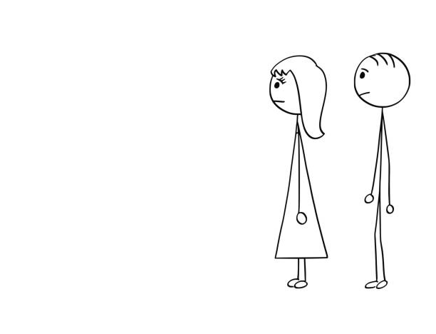
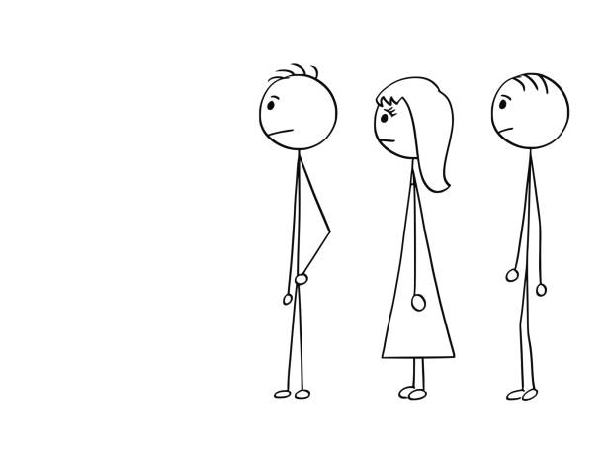



As you were new with the word ‘Queue’ you observed the line very carefully.
The person came to the line first got the service first.

Slide 4

After some time you got tickets and started watching the movie….
Thirty minutes later a buffet scene appeared

Slide 5
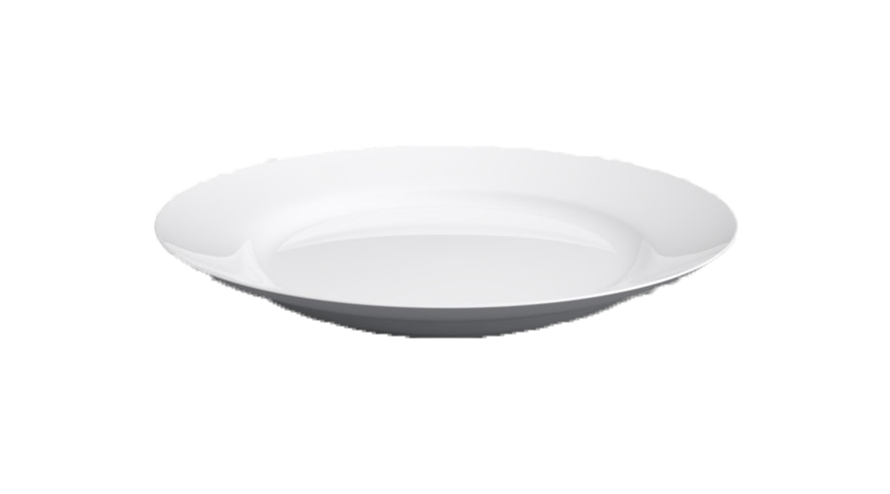
On that scene you noticed that they were using lots of plates in the buffet dinner.
Someone who wanted to take a plate took the top one from the pile of plates.
Cleaners clean the plates and kept it on the top of the plate pile.

Slide 6
Thus the movie came to an end

Slide 7
Always keep in mind that……
Movie line == Queue
Pile of plates == Stack
‘Queue’ data structure follows the same principle as movie line.
Which is First In First Out (FIFO)
‘Stack’ data structure follows the same principle as pile of plates.
Which is Last In First Out (LIFO)

Slide 8
Step Towards Implementation….
Focusing on a simple implementation of STACK and QUEUE
Going to use array to implement STACK and QUEUE.
For the simplicity of implementation we will use push(), pop(), isEmpty() and _size() functions for both STACK and QUEUE data structures.
**Functions name may vary in different implementations. That is not our concern. Once you understand the data structures and implementation techniques function name would not be a headache.

Slide 9
Before moving on ……
Movie line == Queue
Pile of plates == Stack

Slide 10
1. bool isEmpty()
{same for stack and queue}
This function has no parameter and returns a boolean value
Returns true if the STACK or QUEUE is empty
Returns false if the STACK or QUEUE is not empty

Slide 11
2. int _size()
{same for stack and queue}
This function has no parameter and returns a integer value
It returns the number of elements of a STACK or QUEUE
Ex.
    st –
If we call “_size()” function it will return “6” though the index of the last element is “5”
index | 0 | 1 | 2 | 3 | 4 | 5
element | 5 | 7 | 1 | 3 | 8 | 9

Slide 12
3. void push(int element)
{same for stack and queue}
This function takes a parameter and returns nothing
This function insert element to the STACK or QUEUE
index | 0 | 1 | 2 | 3
element
5
3
9
2
push(2)
push(9)
push(3)
push(5)

Slide 13
4.1 int pop()
{For stack}
This function has no parameter and returns an element
It returns the last inserted element from the STACK
index | 0 | 1 | 2 | 3
element
5
3
9
2
pop() will return =

Slide 14
4.2 int pop()
{For queue}
This function has no parameter and returns an element
It always returns the 1st element from the QUEUE
index | 0 | 1 | 2 | 3
element
5
3
9
2
Call1
Call2
pop() will return =

Slide 15


Before implementing the necessary functions
We have to declare a global array of any size
Have to declare a variable which will always carries the index of the last element globally (initially it carries ‘-1’ which points an imaginary index)
Global declaration can help us to access these variables from any functions.
STACK | QUEUE

Slide 16
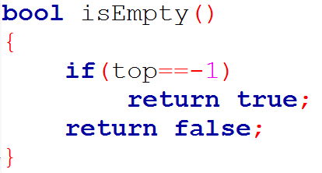
Implementation of bool isEmpty()
STACK
QUEUE

Slide 17
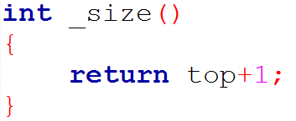
Implementation of int _size()
STACK
QUEUE

Slide 18
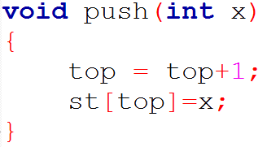
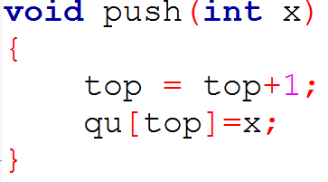
Implementation of void push(int element)
STACK
QUEUE

Slide 19
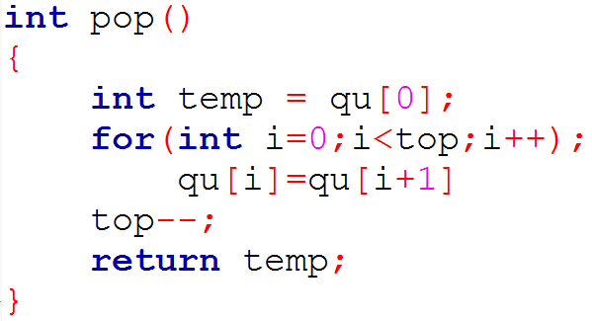
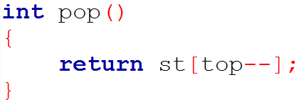
Implementation of int pop()
STACK
QUEUE

Slide 20
Thank you

